Slide 1
Ochrana (nejen) poštovních zpráv pomocí AIP (Azure Information Protection)
Miroslav Knotek
MVP: Cloud and Datacenter Management, MCSE: Productivity
IT konzultant – KPCS CZ, s.r.o.
knotek@kpcs.cz

Slide 2
In the past, the firewall was the security perimeter
users
devices
apps
data
On-premises /
Private cloud

Slide 3






Now there’s fewer boundaries, more data, more complexity
OPPORTUNITY
On-premises

Slide 4





The lifecycle of a sensitive file
Data is detected
Across devices, cloud services, on-prem environments
Data is monitored
Reporting on data sharing, usage, potential abuse; take action & remediate
Data is protected based on policy
Protection may in the form of encryption, permissions, visual markings, retention, deletion, or a DLP action such as blocking sharing
Data is created, imported,
& modified across
various locations
Data travels across
various locations, shared
Protection is persistent,
travels with the data
Sensitive data is classified & labeled
Based on sensitivity; used for either protection policies or retention policies
Retain, expire, delete data
Via data governance policies

Slide 5
Microsoft’s information protection solutions - Today
Comprehensive protection of sensitive data across devices, cloud services and on-premises environments
Devices
OFFICE 365
CLOUD SERVICES, SaaS APPs & ON-PREMISES
PCs, tablets, mobile
Exchange Online, SharePoint Online & OneDrive for Business
Highly regulated
Azure
SaaS & ISVs
Datacenters, file shares
Windows Information Protection
Office 365 DLP
Office 365 Advanced Data Governance
Azure Information Protection (AIP)
Microsoft Cloud App Security (MCAS)

Slide 6
Microsoft’s information protection solutions
AZURE INFORMATION PROTECTION
Classify, label & protect files – beyond Office 365, including on-prem & hybrid
MICROSOFT CLOUD APP SECURITY
Visibility into 15k+ cloud apps, data access & usage,
potential abuse
OFFICE 365 DLP
Prevent data loss across Exchange Online, SharePoint Online, OneDrive for Business
DETECT
OFFICE 365 ADVANCED SECURITY MANAGEMENT
Visibility into Office 365 app usage and potential
data abuse
ISV APPLICATIONS
Enable ISV partners to consume labels, apply protection
MICROSOFT’S INFORMATION PROTECTION SOLUTIONS
WINDOWS INFORMATION PROTECTION
Separate personal vs. work data on Windows 10 devices and prevent work data from traveling to non-work locations
MONITOR
CLASSIFY
OFFICE APPS
Protect sensitive information while working in Excel, Word, PowerPoint, Outlook
MESSAGE ENCRYPTION
Send encrypted emails in Office 365 to anyone – inside or outside of the company
OFFICE 365 ADVANCED DATA GOVERNANCE
Apply retention and deletion policies to sensitive and important data in Office 365
PROTECT
CONDITIONAL ACCESS
Control access to files based on policy, such as identity, machine configuration, geo location
SHAREPOINT & GROUPS
Protect files in libraries and lists

Slide 7
Detect
Classify
Classify
Protect
Protect
Monitor
Scan & detect sensitive data based on policy
Classify data and apply labels based on sensitivity
Apply protection actions, including encryption, access restrictions
Reporting, alerts, remediation

Slide 8
Demo: Azure Information Protection

Slide 9



a
CLOUD & SaaS APPS
Detect sensitive information
ON PREMISES
No matter where it’s created, modified or shared

Slide 10
Classify information based on sensitivity
Business-lead policies & rules;
configured by IT
Automatic classification
Policies can be set by IT Admins for automatically applying classification and protection to data
Recommended classification
Based on the content you’re working on, you can be prompted with suggested classification
HIGHLY CONFIDENTIAL
CONFIDENTIAL
PERSONAL
Manual reclassification
You can override a classification and optionally be required to provide a justification
GENERAL
PUBLIC
User-specified classification
Users can choose to apply a sensitivity label to the email or file they are working on with a single click

Slide 11
Sensitivity labels persist with the document
Document labeling – what is it?
Metadata written into document files
Travels with the document as it moves
In clear text so that other systems such as a DLP engine can read it
Used for the purpose of apply a protection action or data governance action – determined by policy
Can be customized per the organization’s needs
FINANCE
CONFIDENTIAL

Slide 12
Protect sensitive data across your environment
Cloud & on-premises
File encryption
Permissions and rights-based restrictions
DLP actions to prevent sharing
Policy tips & notifications for end-users
Visual markings in documents
Control and protect data in cloud apps with granular policies and anomaly detection
Data retention, expiration, deletion
Devices
Drive encryption
Remote wipe
Business data separation

Slide 13
Keys
There are 3 keys that matter in the main protection workflow
document-specific key (symmetric) to encrypt/decrypt the content
tenant public key (asymmetric) to encrypt the publishing license
tenant private key (asymmetric) to decrypt the publishing license
Local processing on PCs/devices
Microsoft Azure Information Protection
Publishing license
Use Rights +
Symmetric key
Use Rights +
Symmetric key
+
Publishing license
aEZQAR]ibr{qU@M]BXNoHp9nMDAtnBfrfC;jx+Tg@XL2,Jzujdi^os!d
()&(*7812(*:kd
The security of the tenant private key is essential - it can effectively unlock any publishing license and therefore any protected document.

Slide 14

Detect
Classify
Protect
Monitor
Scan & detect sensitive data based on policy
Classify data and apply labels based on sensitivity
Apply protection actions, including encryption, access restrictions
Reporting, alerts, remediation

Slide 15

Monitor information protection events for greater control
Visibility
Policy violations
Document access & sharing
App usage
Anomalous activity
End-user overrides
False positives
Take Action
Tune & revise policies
Revoke access
Quarantine file
Quarantine user
Integrate into workflows & SIEM

Slide 16
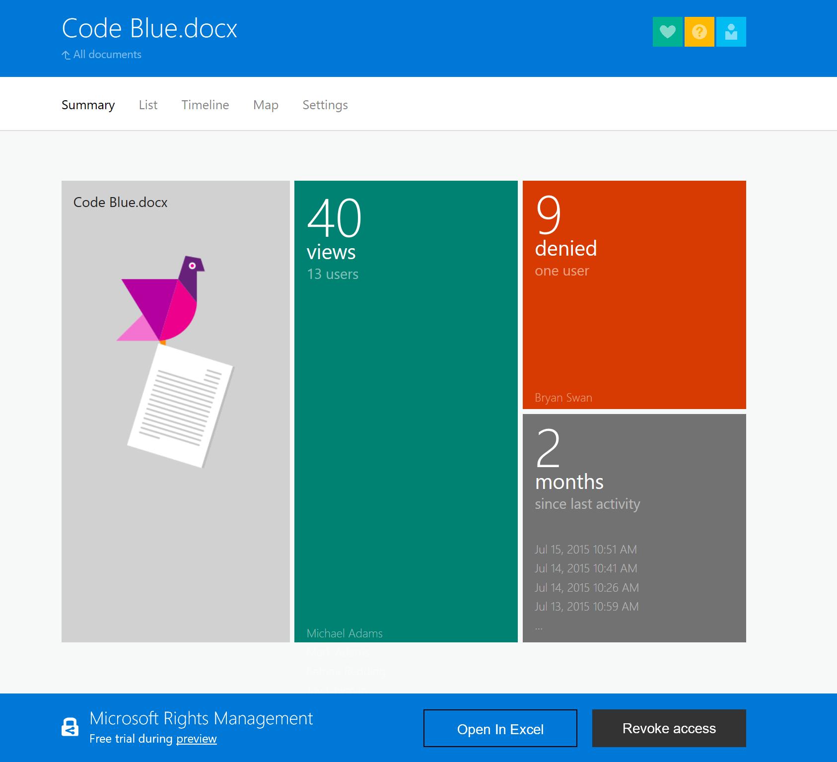
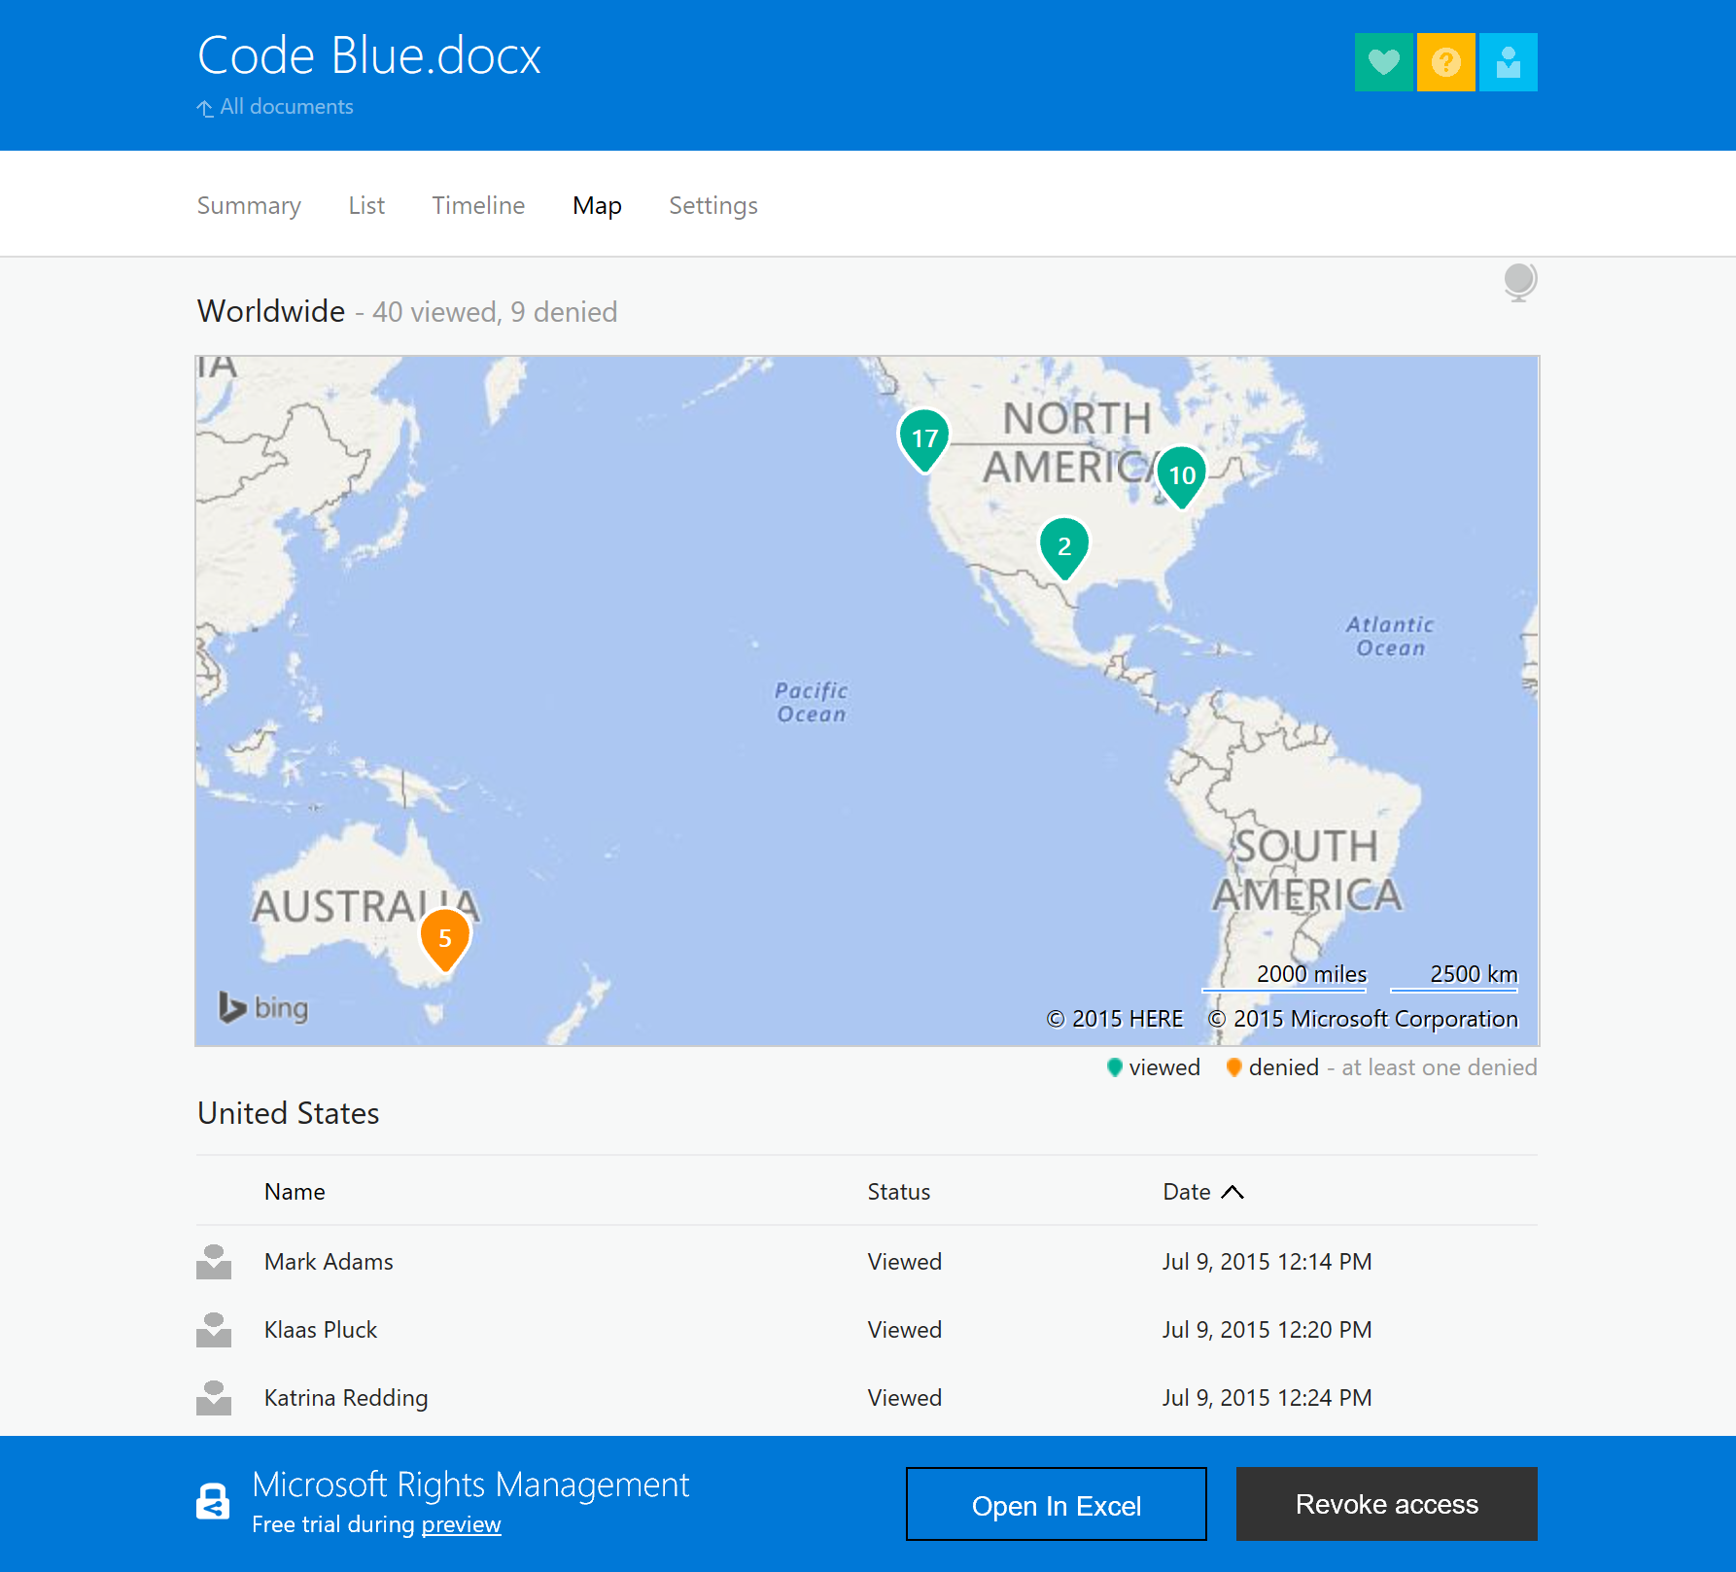
Monitor data access
Notes:
SLIDE OBJECTIVE:
For document tracking, you can get multiple views of who is accessing confidential information – and investigate those denied access to see if there is a security risk.
KEY MESSAGES:
You can also easily track any document protected with Azure Information Protection (formerly known as Azure Rights Management Services).
On the left, you see a summary report that shows number of views, when it has been accessed (in this case it’s been 2 months since anyone looked at it), and who tried to view it but was prevented from doing so.
On the right, you can see there is also a map view that shows where users were located when they access– or tried to access the document.
Because there were several denied attempts in Australia – where the company doesn’t have an office – you know someone was trying to compromise this information. You can drill into those logged access attempts to help determine if this is a real threat.

Slide 17
Information protection portfolio
AZURE INFORMATION PROTECTION
Classify, label & protect files – beyond Office 365, including on-prem & hybrid
MICROSOFT CLOUD APP SECURITY
Visibility into 15k+ cloud apps, data access & usage,
potential abuse
OFFICE 365 DLP
Prevent data loss across Exchange Online, SharePoint Online, OneDrive for Business
DETECT
OFFICE 365 ADVANCED SECURITY MANAGEMENT
Visibility into Office 365 app usage and potential
data abuse
3rd PARTY APPLICATIONS
Enable ISVs to consume labels, apply protection
MICROSOFT’S INFORMATION PROTECTION
WINDOWS INFORMATION PROTECTION
Separate personal vs. work data on Windows 10 devices and prevent work data from traveling to non-work locations
MONITOR
CLASSIFY
OFFICE APPS
Protect sensitive information while working in Excel, Word, PowerPoint, Outlook
MESSAGE ENCRYPTION
Send encrypted emails in Office 365 to anyone – inside or outside of the company
OFFICE 365 ADVANCED DATA GOVERNANCE
Apply retention and deletion policies to sensitive and important data in Office 365
PROTECT
CONDITIONAL ACCESS
Control access to files based on policy, such as identity, machine configuration, geo location
SHAREPOINT & GROUPS
Protect files in libraries and lists`

Slide 18

Existing solutions
Encrypt… without permissions
Incompatible devices/apps/platforms
Inconsistent workflow
Restricted key management
Mail
Encryption
Solutions
Unintended consequence
Complex configuration

Slide 19
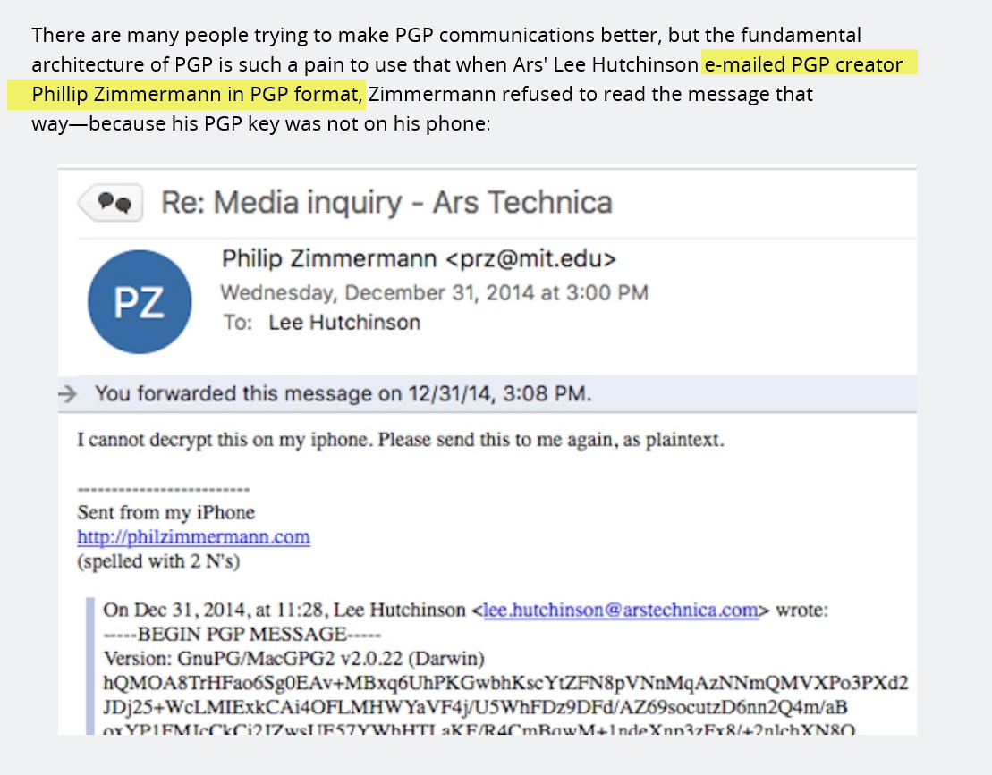
From https://arstechnica.com, 9/26/2017

Slide 20



O365 Message Encryption
Anyone, on any Device in any Email client
Inside your organization
Between your business partners
With any of your customers

Slide 21
Demo: user workflow

Slide 22
Office Message Encryption
Flexible policies
Compatibility across devices, apps, platforms
Consistent workflow
Office
Message
Encryption
Make it intuitive: embed easy, repeatable actions designed to become habitual
Make it flexible: allow broader sharing even with persistent protection
Make it universal: Protect sharing with anyone, including a consistent experience for B2B and B2C
Make it accessible: streamline the recipient experience to be consistent and available on any device, using a variety of ID
Make it work: improve ease of configuration and setup, including policy setting and key encryption management

Slide 23
Admin experience & Policy based protection

Slide 24
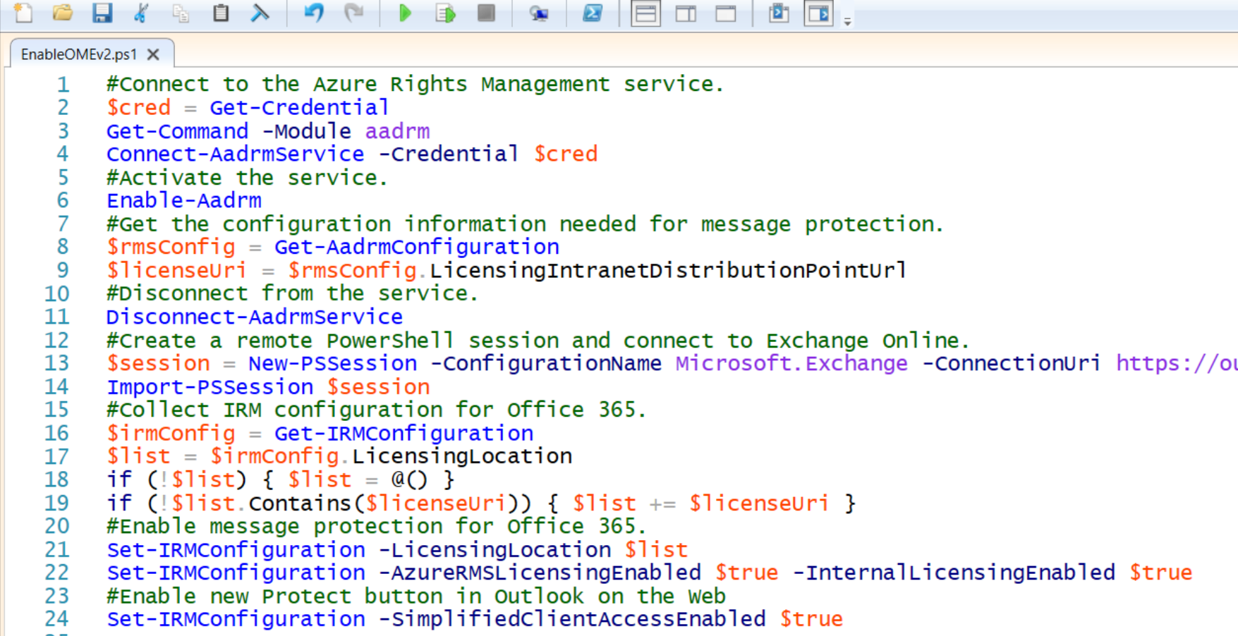
Enable using cmdlet…

Slide 25

But coming soon…
Always On

Slide 26
Office Message Encryption
Compatibility across devices, apps, platforms
Flexible policies
Consistent workflow
Office
Message
Encryption
Easy to configure
Make it intuitive: embed easy, repeatable actions designed to become habitual
Make it flexible: allow broader sharing even with persistent protection
Make it universal: Protect sharing with anyone, including a consistent experience for B2B and B2C
Make it accessible: streamline the recipient experience to be consistent and available on any device, using a variety of ID
Make it work: improve ease of configuration and setup, including policy setting and key encryption management

Slide 27
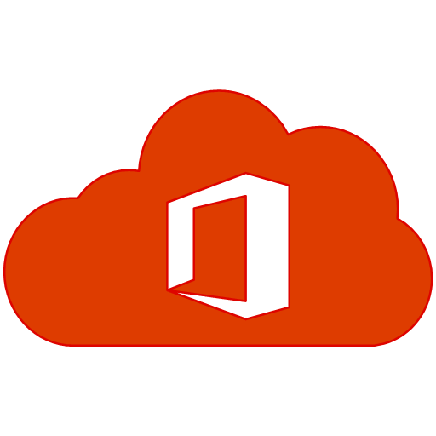


EXO + Your Keys
Azure Key Vault
Azure Information
Protection
Exchange Online

Slide 28
Office Message Encryption
Compatibility across devices, apps, platforms
Flexible policies
Consistent workflow
Office
Message
Encryption
Secure organization
Easy to configure
Make it intuitive: embed easy, repeatable actions designed to become habitual
Make it flexible: allow broader sharing even with persistent protection
Make it universal: Protect sharing with anyone, including a consistent experience for B2B and B2C
Make it accessible: streamline the recipient experience to be consistent and available on any device, using a variety of ID
Make it work: improve ease of configuration and setup, including policy setting and key encryption management

Slide 29
Why Office 365 Message Encryption?
Part of the Microsoft IP portfolio
Easy to setup, manage
Easy workflows for senders & recipients
Consume mails across devices, apps, platforms and mail topology
Full control of your keys

